Slide 1
dittAudio
Matt Morais
Sakthi Vignesh Kanagarajan
11/17/2022

Slide 2

Outline
Who we are
Our Goals
Data Exploration
Recommender System
GUI Design
Impact / Usability
Demo

Slide 3
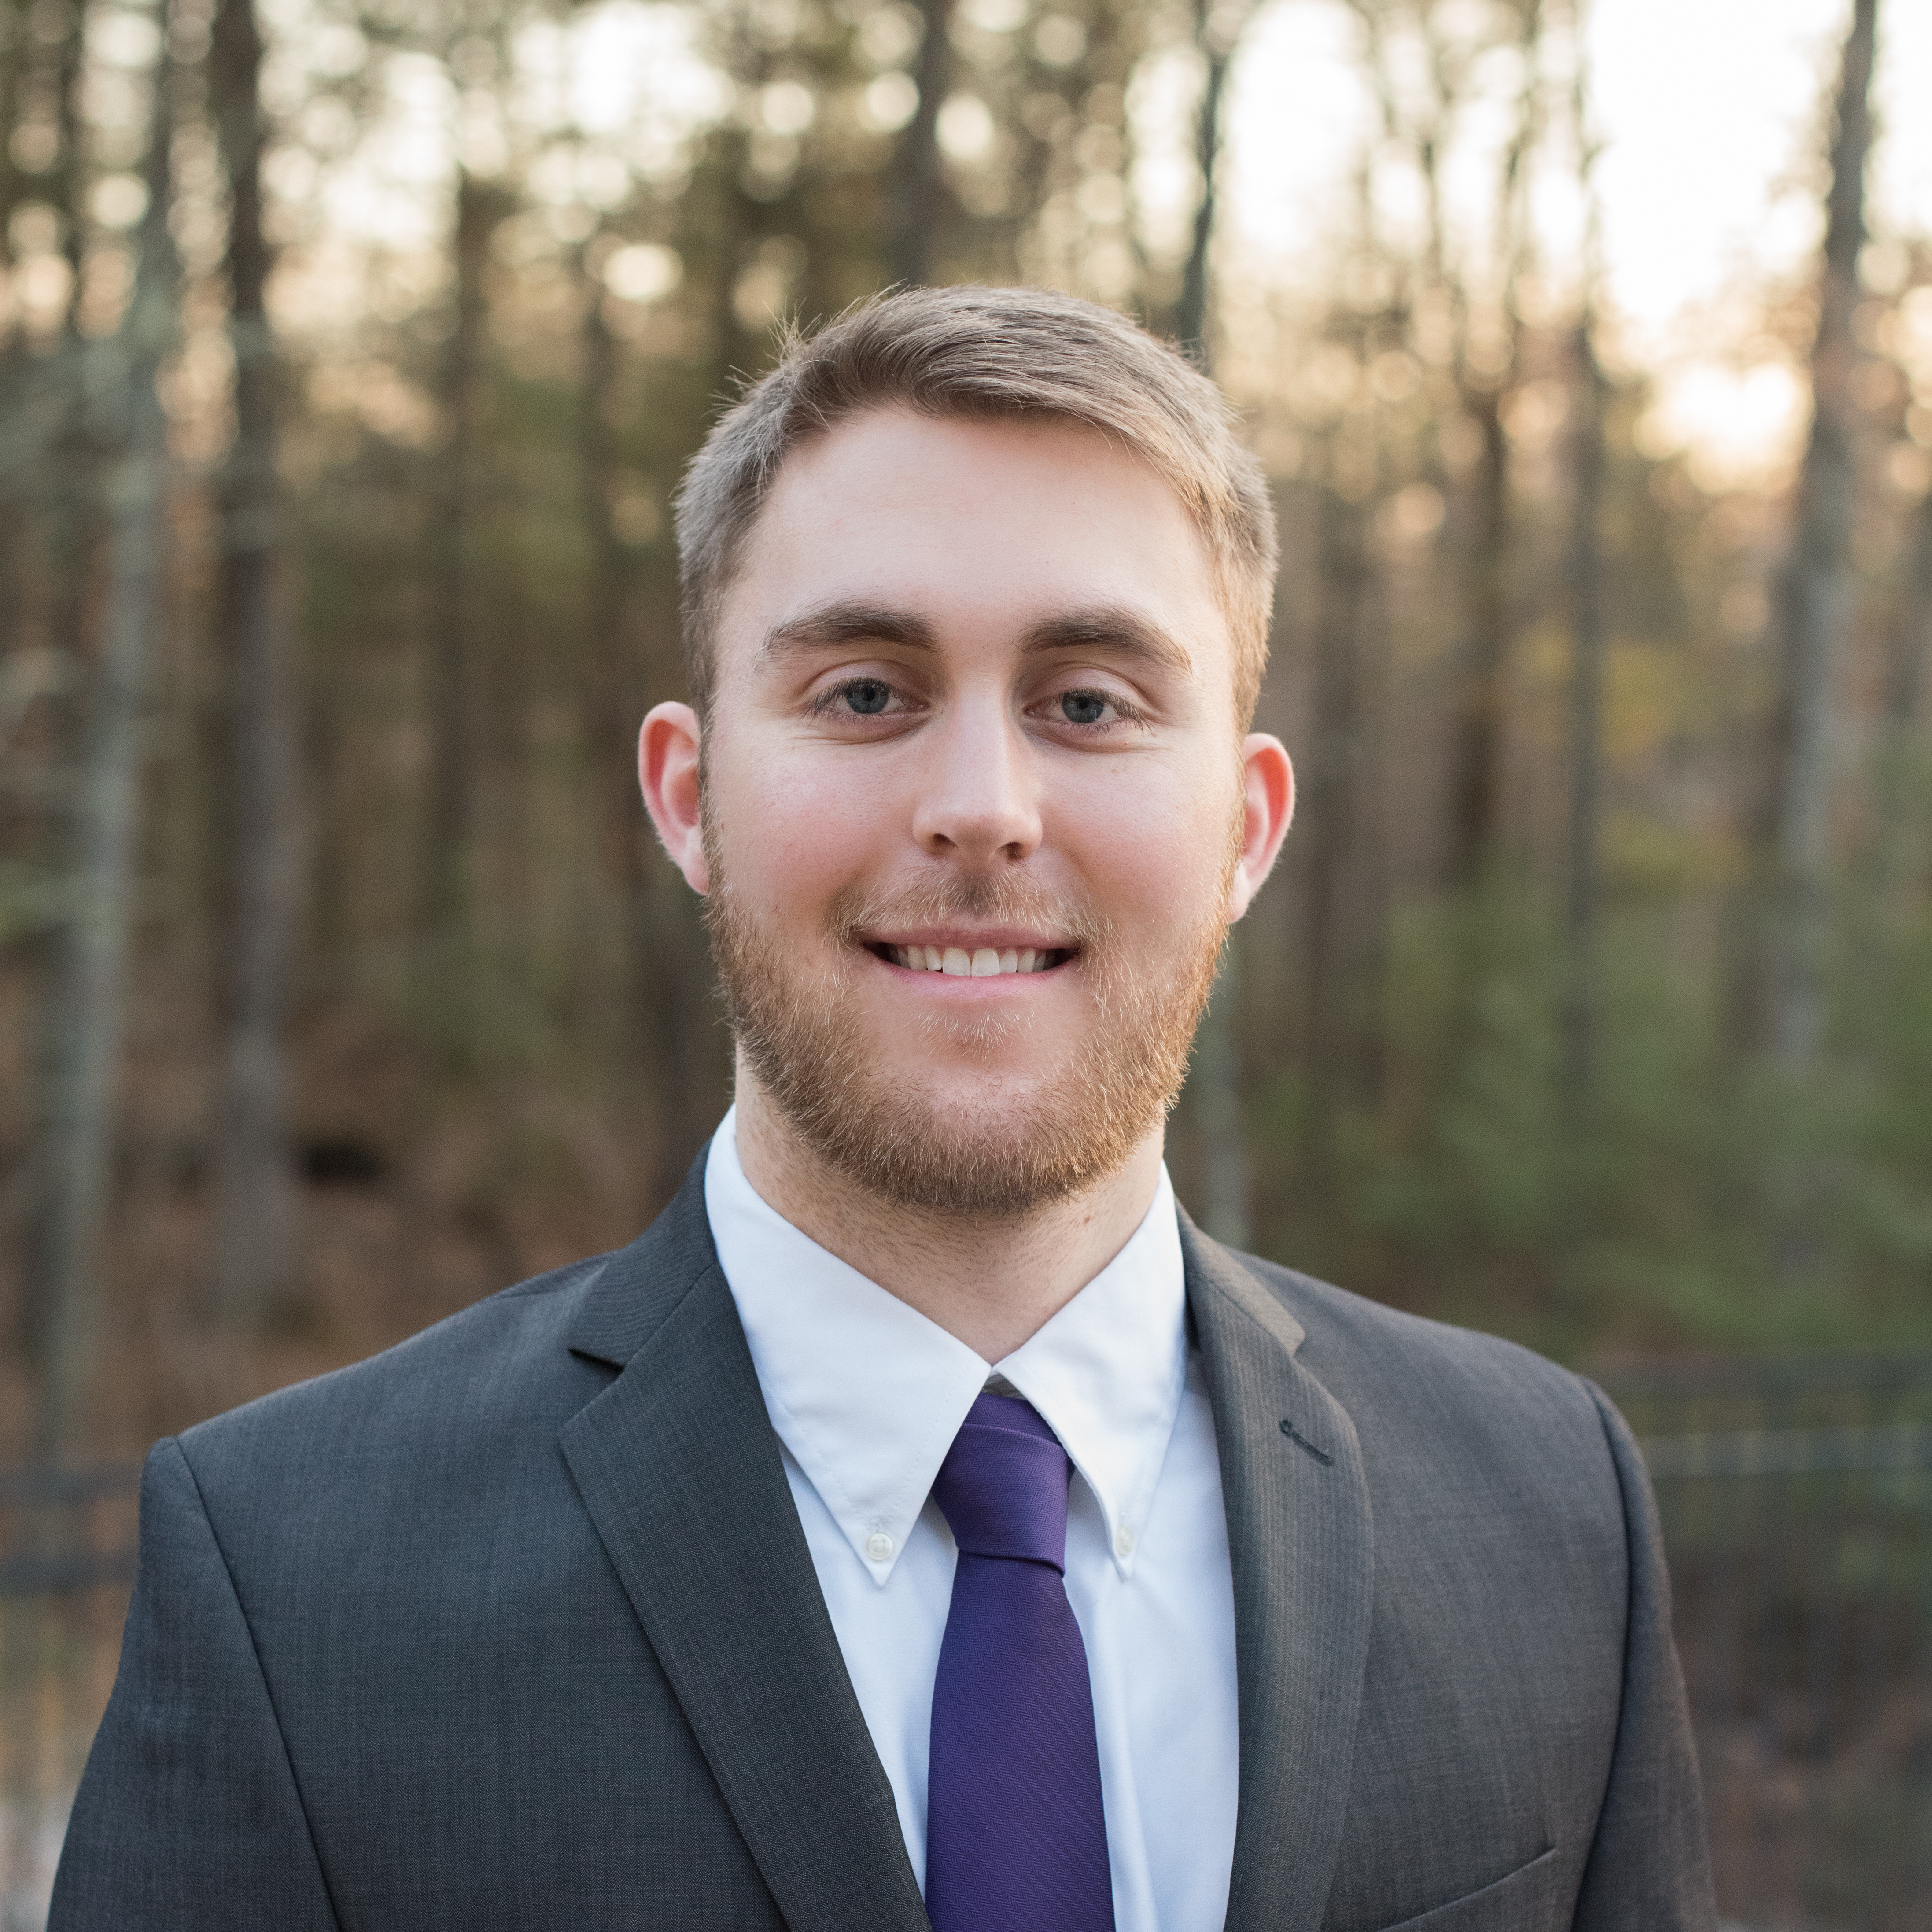

Who we Are
Matt Morais
Data Science / Computational Methods
BAE Systems, Senior Software Engineer
Lowell, MA
Sakthi Vignesh Kanagarajan
Data Science / Computational Methods

Slide 4
Goals
Goals | Met | Design Discriminators
Content Recommending | Yes | Easily expandable as new music is released
Collaborative Recommending | No | Popularity rating for songs - psuedo collaborative
Create Playlists | Yes | Add to existing or make a new one!
Play songs on user device | Yes | Defaults to Computer, backup is mobile
Expandable Code | Yes | Utilized Object Oriented recommender classes
Simple, yet customizable GUI | Yes | Designed using base python install, no extra packages!
Develop a complete Application | Yes | Ready for launch utilizing Spotify API
Lowkey Jam Toggle | Yes | Hipster Toggle button on GUI
Generate Own Dataset | No | Query Request limits
Accessible by All | No | API usage requires Spotify Premium

Slide 5


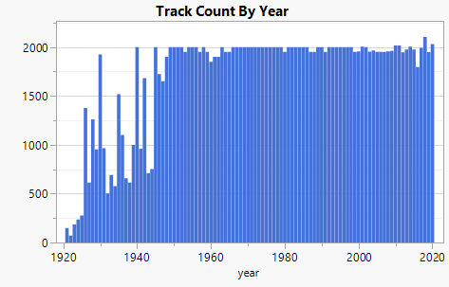
Data Origin
~170,000 songs from 1920-2020
All tracks processed using same signal processing technique for feature extraction
Have to package recommendation song library with application
Easily modifiable, just swap a single variable in code
Keeps application small in size and performance fast
Allows User to use their own recommendation library
Targeting rec’s after 1960 (more diversity, more accurate recommendations)

Slide 6
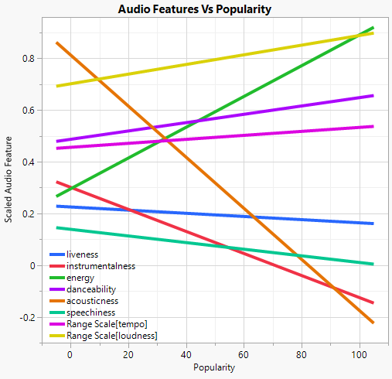
Feature Selection
Energy
Loudness
Danceability
Acousticness
Speechiness
Tempo
Loudness

Slide 7
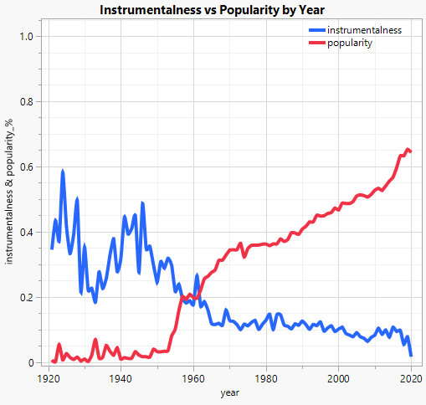
Feature Selection
Reasoning for neglecting instrumentalness
Really only pertains to classical / ragtime music (pre-1945)
Want to recommend based on current music trends, which differ greatly from audio features of classical music

Slide 8
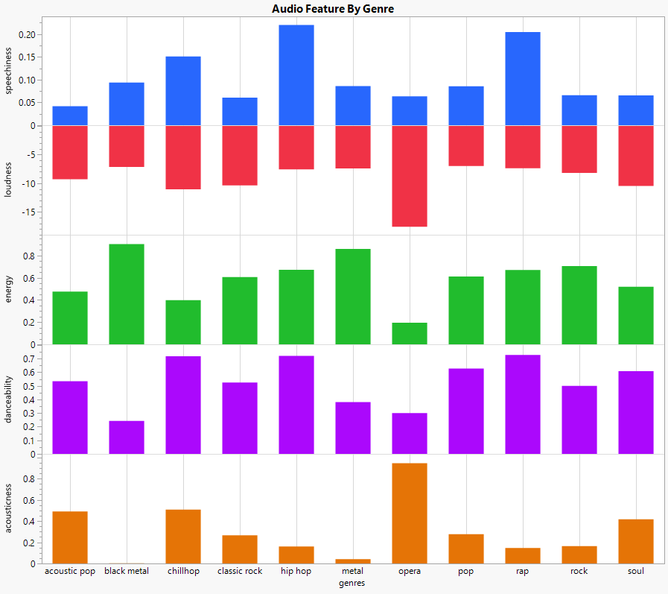
Feature Selection by Genre
Highest Speechiness
Rap, hip hop
Highest Energy
Metal
Highest Acousticness
Opera
These genres and ~3000 more characterized for advanced usage

Slide 9

Implementation of K Means Clustering
K means clustering receives a single hyperparameter k which specifies how many clusters we want to categorize our data into
Our Spotify data has been divided into 20 clusters (n_clusters = 20)
Normalization Method : Standard scaler
Relevant features were chosen by correlation with variable ‘Popularity’
Features :
Danceability
Energy
Loudness
Speechiness
Acousticness
Liveness
Valence
Tempo
The pipeline has been fit with features which result in cluster labels.
These cluster labels show which track falls into which cluster
Fit
Predict

Slide 10
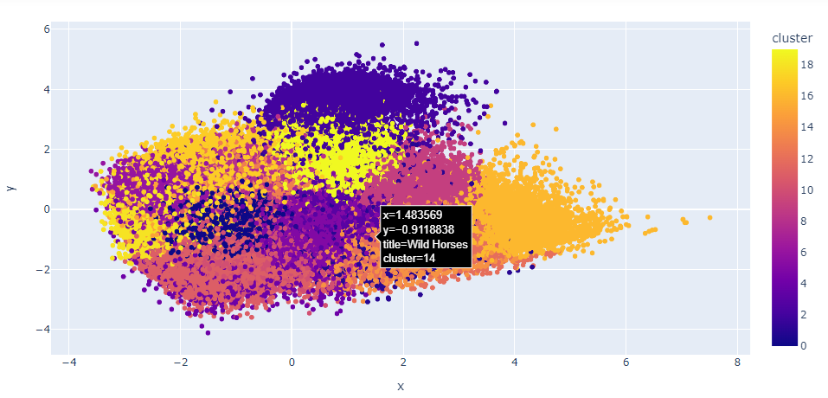
Visualizing the clusters
Final Project Presentation

Slide 11
Implementation of Content-based recommendation algorithm
Song data
Recommendation Algorithm :
The data has been scaled using standard scaler.
Song centers are retrieved using mean vector.
Distance between scaled data and its center has been calculated using cdist function.
With distance as parameter use the argsort to find the recommended songs.
Mean Vector Calculation:
Extract the song data values.
Convert into an array and calculate the mean and return it.
Output
Recommended songs
Calculated mean

Slide 12
Working flow of DittAudio Recommender
Receive the input from DittAudio GUI
Create the DittAudio Object which builds the pipeline using K means Clustering
Call the recommender with the input values
Sends the output to GUI which contains TrackID and song name
Calculate the distances and perform sorting and return the n number of recommended songs from Spotify CSV data
Calculate mean and transform the data using Standard scaler

Slide 13
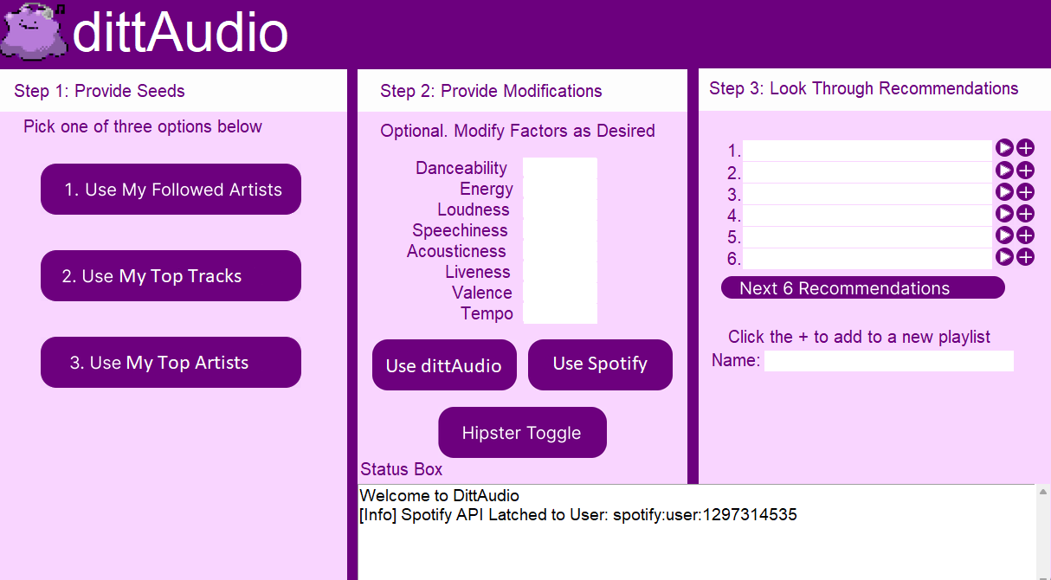
GUI Design
Three step interface
Automated model input parameter settings based on user profile
Safeguards from crashing
Simple operation, only need a mouse!

Slide 14
Demo Time!

Slide 15
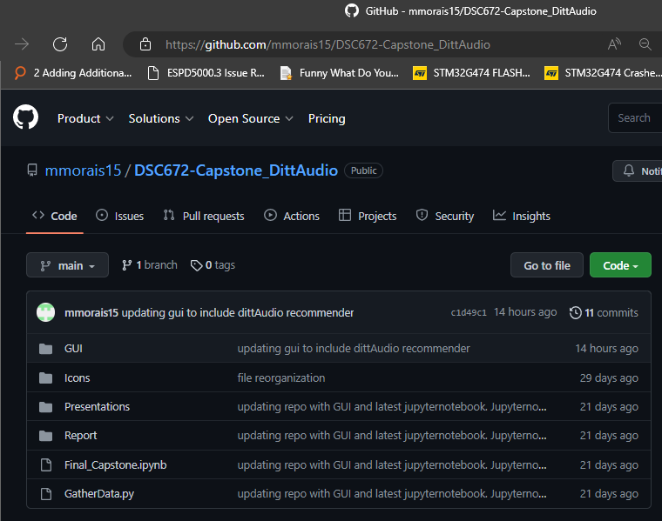
Impact / Usability
Anyone with a Spotify Premium account
Modular, can swap in and out recommender algorithms
Good starting point for others in the field wishing to develop
All open source on Git Hub!!
It would be great for others at DePaul to continue this project in their own capstones
Does require certain versions of scientific python packages. Virtual Environment available on Git Hub.
GitHub - mmorais15/DSC672-Capstone_DittAudio

Slide 16
Thank you!
Questions? Comments?
Matt:
mmorais1@depaul.edu
Sakthi
skanagar@depaul.edu

